Slide 1
BSIP ++ Guidance, and a Proposed Strategy for Allocation
Timothy Stephenson
Graeme Mateer
September 2023

Slide 2
BSIP:Background
The original BSIP (Bus Service Improvement Plan) was launched in 2022 under the banner of Bus Back Better
BBB originally proposed an overall budget of £3bn for bus travel
DfT received over £7bn in applications. Suffolk submitted a bid £77m/£106m (exactly the same as Norfolk)
Around 31/79 Local Transport Authorities received a share of £1.1bn BSIP funding. Unfortunately, Suffolk did not receive BSIP funding.
Suffolk’s response:
Asked for feedback from the DfT
Formed an Enhanced Partnership (EP)
What can we do within existing budgets
How do we persuade DfT that Suffolk is a place worth investing in?

Slide 3
DfT Feedback
Dft Suggestions
Suffolk response
Implement an EP ✓
Develop a pipeline of schemes X
Introduce a Customer Charter ✓
Branding and Marketing ✓
Ticketing schemes (£2 fare cap came in since this was suggested) ✓
Upskill the transport workforce within the Council ✓
Link everything to Local Transport Plan (LTP) and Active Travel (AT) ✓
X The DfT judged our BSIP good but below the threshold for funding. One area we could improve on was that we had no pipeline of schemes prepared and ready to be implemented – without this we could not deliver “at pace”
We have already started or implemented most of the left-hand side of the page
What else could we do?
Continue to lobby the DfT to invest in Suffolk
Explore the idea of taking people to the bus rather than the bus to the people ✓
Heat mapping to identify areas of transport desert ✓
Engage with communities about transport needs ✓
£300k DfT funded capacity grant received in 2022

Slide 4
Suffolk Enhanced Partnership (EP)
Our Enhanced Partnership (EP)
The BSIP is “what you will do – the EP is the legal framework for how you deliver the BSIP” (DfT)
Launched in 2022 – one of the first in England
Initially runs for three years with an option to extend to five years
Chaired by Councillor Alexander Nicoll
Representatives of the large/medium and small bus operators and Suffolk County Council
Various sub-groups to feed into the EP Board
Community Transport, Transport Focus (Bus Users), District Councils, Community Groups and Elected Members
Having an EP effectively ringfences Transport budgets for the duration of the EP

Slide 5
Further Meetings with DfT
Met with DfT on 2nd May 2023. We were the first Local Authority which did not receive the original BSIP funding to meet DfT
We made the case for investing in Suffolk and we invited a number of guests (Operators, Transport East, Community Transport) to make the case specifically for rural transport
Showed them our Heat Mapping Tool for identifying “transport deserts”
Had a good discussion on “alternatives to the bus”
End of May 2023 DfT announced BSIP+ a fund available to any Local Authority not in receipt of the original BSIP funding
DfT relaxed some of the conditions for original BSIP and promised terms and conditions for BSIP+
Suffolk was granted £1.87m for financial years 23/24 and 24/25 (£3.7m in total) however, by accepting BSIP+ we effectively ring-fence transport budgets until 2025

Slide 6
Terms and Conditions BSIP+)
Revenue Funding
Can be used for:
Revenue Funding
Cannot be used for:
Supporting the existing bus network
Travel Hubs
Extending current bus routes e.g., evenings/weekends
Reviving lost bus routes
New bus routes
Operators may have suggestions
Linking communities to the current bus network by various providers
Community Empowerment
Construction i.e., road-based schemes e.g., bus priority, bus lanes etc
Infrastructure However: DfT have indicated that it may be possible to convert a small portion of BSIP+ for bus shelters, timetable cases, flags and poles etc

Slide 7
Thermotic Mapping (or Heat Mapping)
We already had the tool and had used it for mapping Active Travel
Uses data from every household in Suffolk (343k)
Allows the user to input various “services”
Access to GP or Hospital
Shopping/banking etc
Leisure/libraries/FE etc
Employment
Overlay existing bus routes and distances for walking/cycling/driving
The mapping tool calculates “hot and cold”

Slide 8
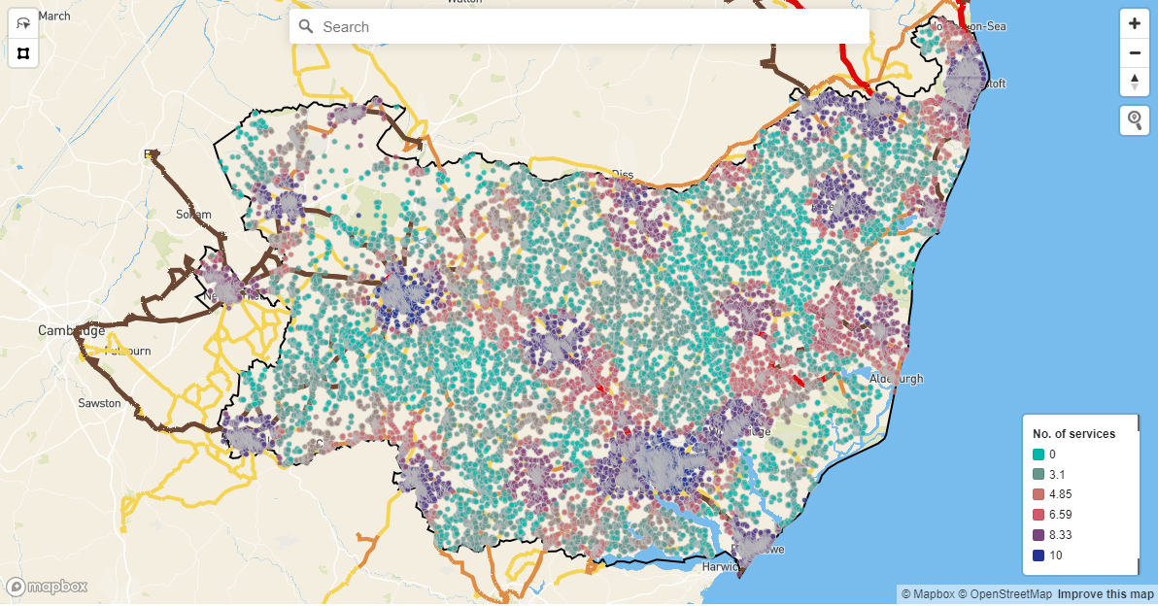

Slide 9
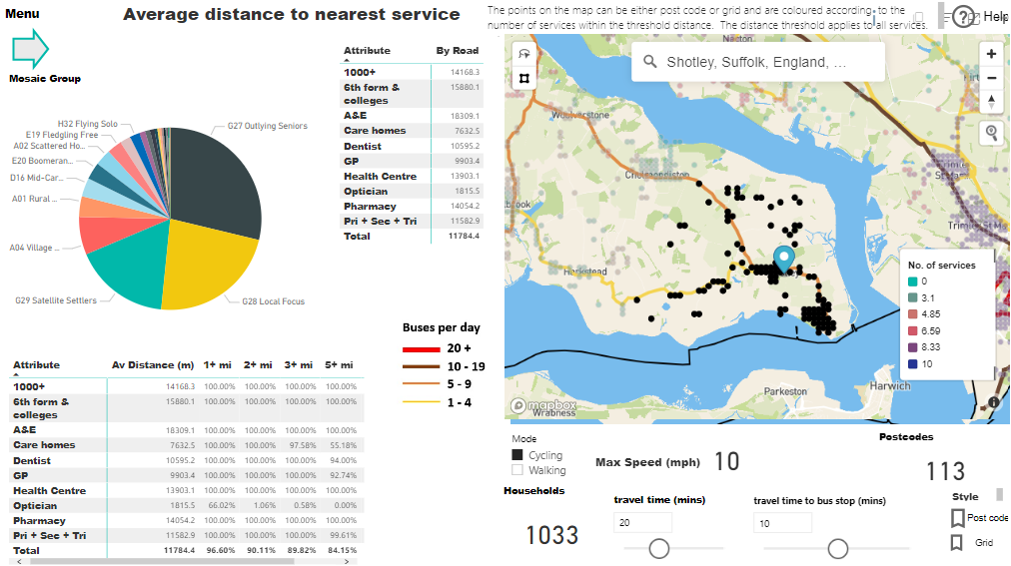
Demo
We can zoom in or search for a community
Use the lasso to find out more

Slide 10
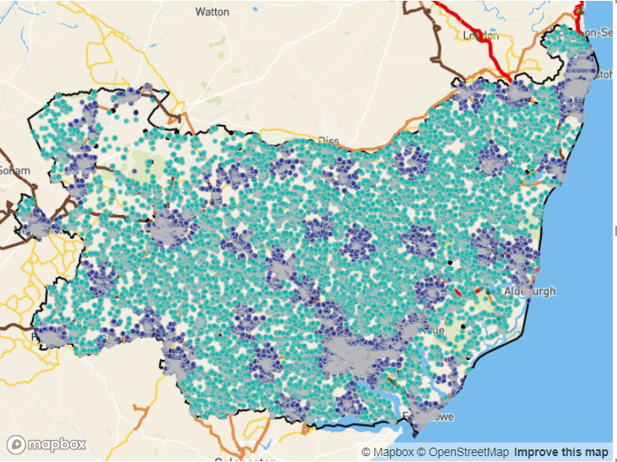
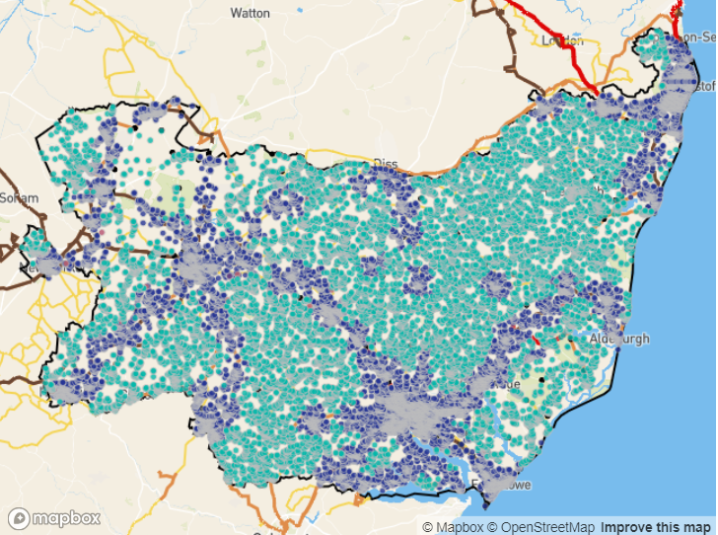
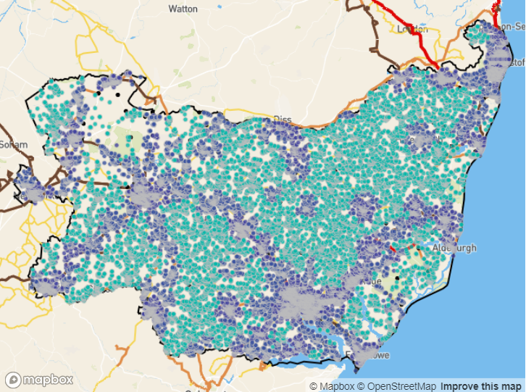
Phase 3
To combine ‘direct access to a service and bus stop’ with access to a service hub.
+
=
Producing statistics on the difference (phase3 – phase2).
(those households that needed a service hub for the services selected).

Slide 11
Thermotic Map – How will we use it
The proposed strategy is to identify areas of transport desert
Then identify the potential sites for travel link sites
Village halls, central points, car parks etc
Link to the existing bus network via Travel Hubs using various local transport options
Social car schemes
Taxi bus
DRT (demand responsive transport)
How will it work?
Communities will lead on what/how/when and promotion
The Council provides the funding and the expertise
All schemes will be evaluated so data will be important

Slide 12
What will the process for accessing BSIP funding look like
Not intended to replace Community Transport (already funded annually £1m)
Bus Companies may bid for new/revised timetables, and this may take up a large share of BSIP+
Communities may bid for local transport links/local hubs etc using CT’s or other transport providers
SOAP Scheme On A Page (Example attached)
Potentially grants of £25k or £50k per SOAP (equates to £500/£1000 per week)
Elected Members to coordinate and encourage their communities to apply for BSIP+ funding
Schemes should include an outline of potential timetables, journey frequency and likely passenger numbers. Also, destinations, purpose of travel and how the community can promote using the route (a template will be provided)
Funding assessed and awarded by the EP (or EP sub-group) using a clear and agreed formula
All schemes will be continually assessed so operators and communities need to keep good records/data
Any schemes considered to be “failing” based on the data, will halt and the funding will be re-allocated (“use it or lose it” principle)

Slide 13
Scheme on a Page – Stage 1 Bid:
Why do we want to do this?
What is the proposed Scheme?
How does this scheme meet the Council’s Objectives?
How will we know if the scheme has been successful?
What are the indicative costs and benefits?
Is there a financial return on investment?
What is the estimated cost to deliver?
What are the non-financial benefits?
What are
the key deliverables and timescales?
What do you need to do or change to achieve this?
What is the level of complexity?
When does it need to be completed by?
What are the key deliverables that will be produced?
Decision requested:

Slide 14
SCEP delivery project overview:
Why do we want to do this?
What is the project?
Travel Hubs: we plan to introduce a new travel hubs to an isolated community (based on existing “heat mapping” which identifies areas of transport desert in Suffolk, who don’t currently have access to bus services. These hubs will be served by DRT; shared car, taxi or minibus (all could be EV) and meet existing bus routes (supporting the bus network) Hubs will include shelters, real time info, and cycle racks to enable different models to use them and will be sited on existing sites
How does this project support delivery of the SCEP and environmental improvement?
Reducing reliance on the car
Cutting down parking in our villages and tons
Supporting existing bus routes
Providing new routes from communities who don’t currently have transport
Appropriate transport foir the situation
Works closely with Active Travel values
How will we know if the project has been successful?
Increased patronage on local bus services (which is measurable via electronic ticket machine data)
Patronage via local community based data for the shared car/taxi or DRT scheme (collected and collated locally)
Via feedback from local members – we will know if this is successful by the number of elected members asking for a similar scheme in their area
Passenger Survey data
What are the indicative costs and benefits?
What is the estimated cost to deliver? = £110k
Gold shelters are approx. £50k each
DRT or shared taxi schemes roughly equate to £500/week. A valid scheme needs 2 years to bed in (based ion national data for DRT) = £50k per scheme
Advertising/bus info £10k (2 years at £5k ea)
Community assistance (Officer time) for tendering/contract management etc would be offered free by SCC
What are the financial and non-financial benefits?
Support to the local bus network – which has been struggling post Covid
Increased patronage = increased access to local services such as retail, health, work etc
Non-financial; reducing social isolation, increasing inclusion, greater accessibility and there is good data nationally on how access to transport = benefits wellbeing/mental health
What are
the key deliverables and timescales?
What do you need to do or change to achieve this?
Full community engagement
A change in public mindset about how DRT can interact with bus services
Positive advertising
Time for the DRT to bed in (usually 2 years)
What are the implications if this project is not supported?
Bus services and service funding is under threat across the UK based on a lack of patronage, increased car usage and the after effects of covid. Reducing the current bus network will lead to increased social isolation, a lack of public accessibility and an increase to ACS budgets
What are the key timescales and deliverables?
Travel Hubs are in the Councils BSIP. Suffolk did not receive BSIP funding. We cannot afford to deliver travel hubs without new funding. We could start to deliver travel hubs quite quickly because no new infrastructure would be needed – we intend to use existing sites; car parks, village halls etc
Decision requested: We realise that £ is a huge ask to deliver one travel hub but we believe this will make a huge difference to the local transport network and have really useful outcomes for inclusion and isolation agendas. Our BSIP suggests we will introduce two of these travel hubs per year – we think we could possibly introduce three per year but we would require funding for each. So, if more funding were available – this scheme is scalable

Slide 15
How much funding is available?
Year 1
now to 31st March 2024
£450k already allocated to keep the bus network stable – vitally important
£150k allocated for developing a pipeline of bus priority schemes (as per the DfT instruction in slide 3)
Remaining Total - £1.2m which could be available for new/amended bus services or local travel hubs and links to the existing bus network or new and innovative ticketing schemes (also on slide 3)
Year 2
April 2024 - March 2025
So far £1.87m Unallocated

